Slide 1


Ed Larson
02/02/2017

Slide 2
Openwerx challenge
Drone Hacking
Notes:
This slide can be used as a background before the presentation begins.

Slide 3
Goal 1: Find as many vulnerabilities in the system(s) as possible
  Command and control
  Onboard video subsystems
Goal 2: Produce exploits and delivery mechanisms
  Drones available at SOFWERX (Tampa) and xx (NC) for testing
  Destructive testing not allowed

Slide 4
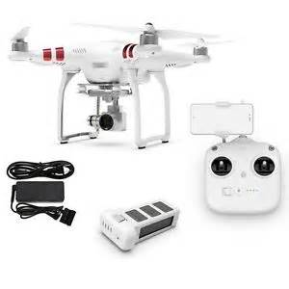
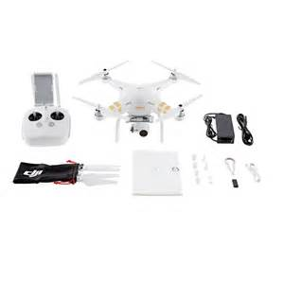
DJI Phantom 3 DJI Phantom 4

Slide 5

SSID, MAC, passwords, fixed IP addresses, ftp active, file system accessible (deletion/insertion, do not fly list, RTH file, file access rights), denial of service, Aircrack, Skyjack, kill command, GPS, frequency jamming, FPV jamming, phone app

Slide 6
We were able to find the MAC address of the drone without connecting to the drone or the network.
We knew DJI was the manufacturer of the drone.
  OUI portion is available online.
The last 6 digits of the SSID is the rest of the MAC.
We easily obtained SSID and MAC
We could then use Aircrack on the drone

Slide 7
We were able to ftp to the drone while it was in flight. Although the User was jailed in the /tmp directory we were able to access the directories and files on both the controller and the drone.
We could read, write, and delete files.

Slide 8
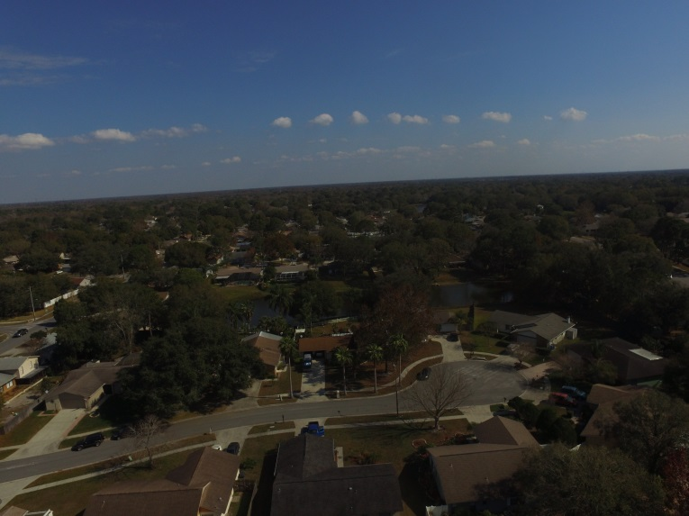

We could access the camera and download files and UPLOAD new files in their place!

Slide 9
We found the Busybox executable and used chmod to turn it off!
This caused the camera to quit working on the next reboot!
The drone was then unable to initialize its network connection and we were unable to ftp to it.
The firmware had to be reloaded to fix the problem!

Slide 10
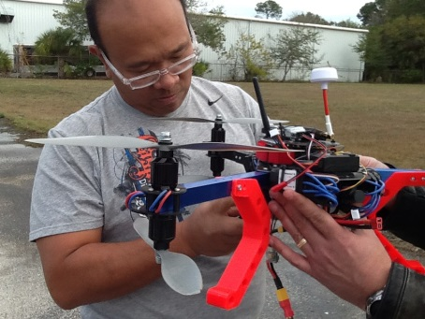
We were able to use Aircrack to compromise the network of the drone.
We were also able to mount a Pi Zero with Aircrack and Skyjack software onto a “friendly drone” to attack the target drone. We did this with the P3 and P4.

Slide 11
We are confident that the Phantom 3 is vulnerable to WiFi jamming and GPS jamming, but we did not conduct these tests due to FCC and FAA regulations.
Our team does possess the necessary tools to do so however.

Slide 12

Frequency jamming, GPS, FPV jamming, phone app, obstacle avoidance (laser blinding, sonar jamming)

Slide 13
We attempted to locate the drone’s SSID and MAC using Aircrack and by scanning then 2.4 Ghz band. We were unable to distinguish the drone’s communications from the other network traffic in the area.
Given more time we may have been able to find the network for the Phantom 4.

Slide 14
The Phantom 4 uses a 40 kHz sonar plus 2 optical sensors for obstacle avoidance.
It is possible to jam this with another 40 kHz sonar signal.
It may be possible to blind the optical sensors with laser light.

Slide 15

Both drones use a publically available phone application. It may be possible to compromise the app with a Trojan Horse, virus, or spybot program.

Slide 16
As previously mentioned: both drones use common communications frequencies which can be jammed.
The controller and camera communicate separately. It should be possible to jam one and not the other.

Slide 17

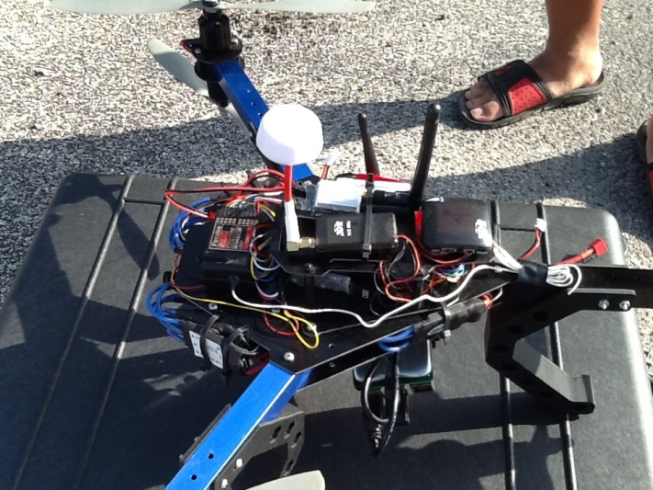



Our team proposes that the best solution to combat both drones is with a small group of “Hunter/Killer Drones” designed to jam GPS, WiFi, and controller signals.
The Hunter/Killers could also be equipped to use Aircrack and Skyjack software to defeat the P3s.
The drones are difficult to control without a good GPS fix and cannot Return to Home if the GPS signal is compromised.

Slide 18
The Hunter/Killers could be deployed by ground personnel or by using a low velocity projectile device. This is what we call “Projectile Deployed Defensive Drones” or PRODDD.
If the Hunter/Killers are compact enough, 4 or 5 could fit into a 5 inch diameter projectile about a foot long and launched using an air cannon, similar to how T-shirts are delivered at sporting events.
PRODDD would be portable, easily used, and relatively quiet.

Slide 20


